Slide 1
Optical Coherence Tomography for Robotic Brain Surgery
Neuralink, US 2021/0007808 A1, Published 1/14/2021
7/1/2024

Slide 2
Background
Brain implants require delicate control for secure insert & attachment
Computer vision for surgical robotic surgery becomes problematic in discerning varying layers in brain + shadows casted via surgical tools, already implanted electrodes, etc.
Implantation with specific accuracy becomes difficult in the presence of background movement (e.g., blood flow, natural brain movement, breathing, heart rate), fluid membrane on brain surface, and determining proper depth for implantation

Slide 3
Outline
Goal: Describe application for guiding robotic surgical systems via optical coherence tomography (OCT) by acquiring depth maps of wet brain surface or other tissue surfaces
Embodiments:
System Overview
Robotic Surgery System using Optical Coherence Tomography (OCT)
Close-up bottom view of system
Overhead Image of a Portion of Brain
3D Image showing Surface Topology of Brain
Cross-Section of Head with Portion of Skull Removed
Real-Time Imaging Process: Optical Coherence Tomography (OCT)
Electrode Implantation – Why OCT Alone is Not Sufficient
Implantation of Electrodes in Target Tissue Proxy Substance
Electrodes implanted in brain tissue
Shadows Cast By Threads
Occlusions Casted from Fluid & Vessels
Example Computing System + Components

Slide 4
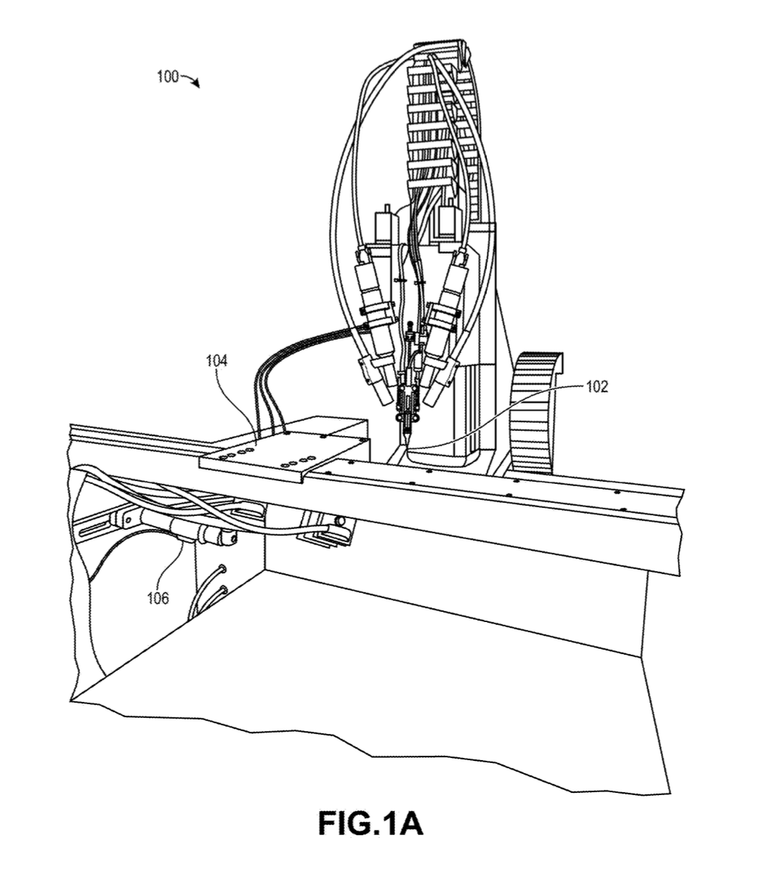
Robotic Surgery System using Optical Coherence Tomography (OCT)
Device engagement subsystem
Inserter Head
Ultrasonic Cleaner

Slide 5
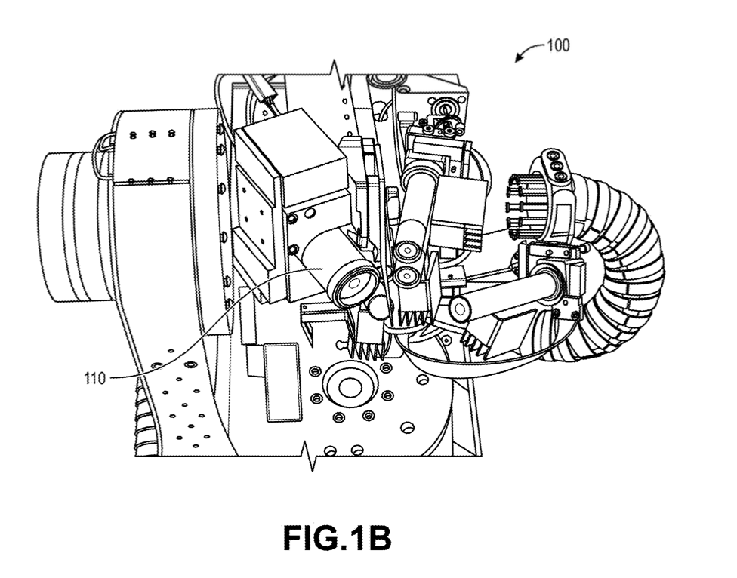
Close-up bottom view of system
OCT sensor

Slide 6
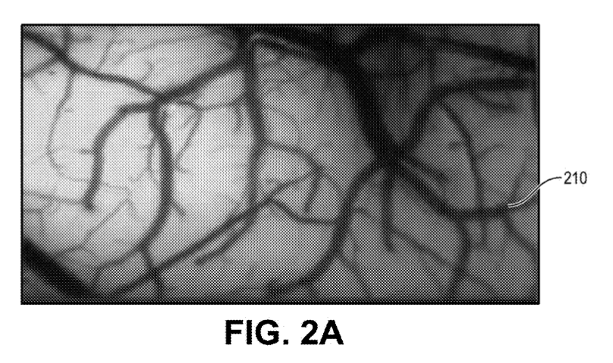
Overhead Image of a Portion of Brain
Avoid vasculature during brain surgery
Can select needle insertion location automatically
Vasculature
(need to be avoided during surgery!)

Slide 7
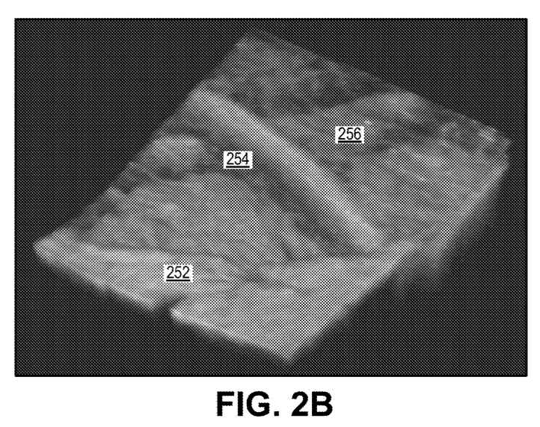
3D Image showing Surface Topology of Brain
The environment is complex, dynamic – surgery must adapt for factors that impact precision + accuracy!
Very challenging to process & understand brain surface quickly to guide inserter head
Subarachnoid space
Brain surface undulating (dynamic)
Blood vessel
(pulsating)

Slide 8
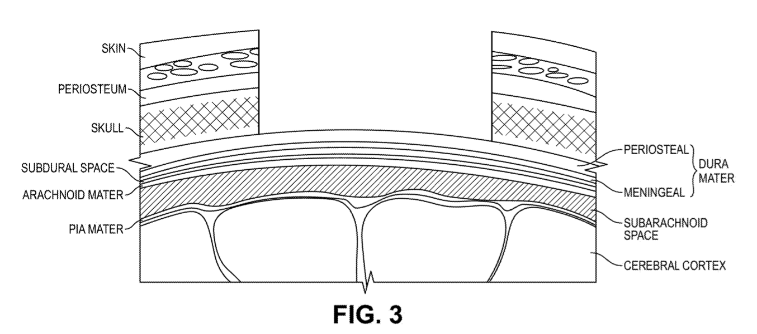
Cross-Section of Head with a Portion of Skull Removed

Slide 9
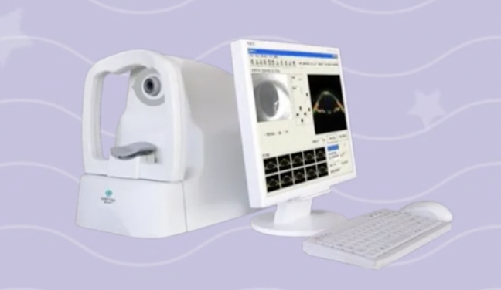
Optical Coherence Tomography (OCT)
Used to guide a robotic system to surgically implant electrodes
Can quickly generate depth maps of brain surfaces to ensure precision of surgical robotic system
Performed by OCT sensor
Obtain stack of 2D arrays of intensity values (light bouncing back to sensor)
Can obtain tens of millions of points
Each slice – different depth layer
120-160 slices in a stack
May select 10-30 slices based on spatial selection for targeted insertion sites

Slide 10
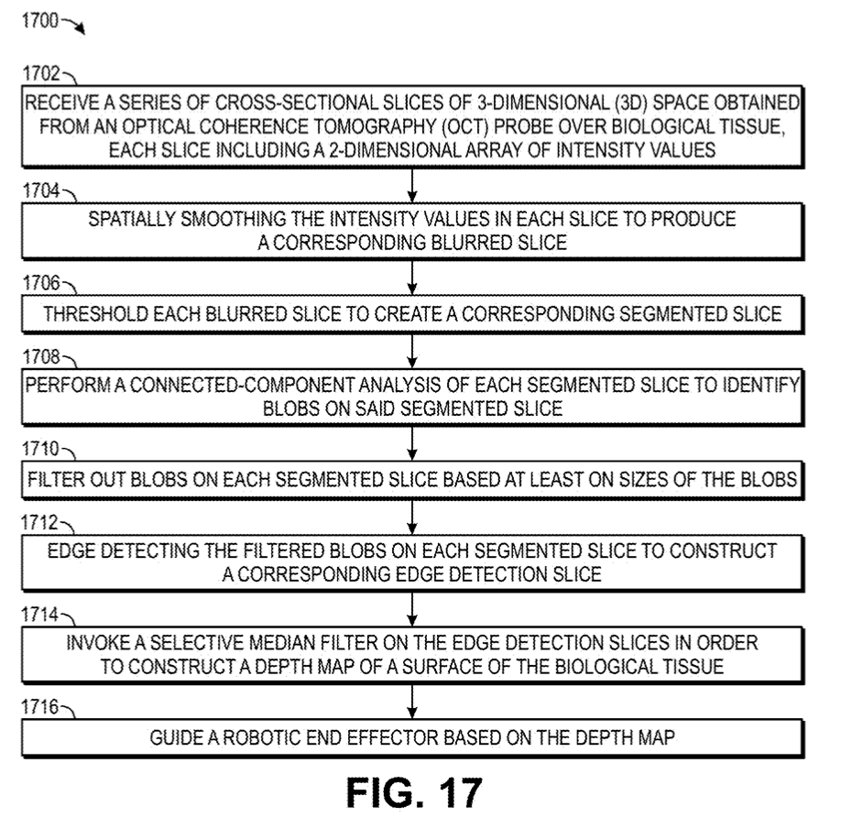
Flowchart for Guiding Robotic Surgery via Optical Coherence Tomography

Slide 11
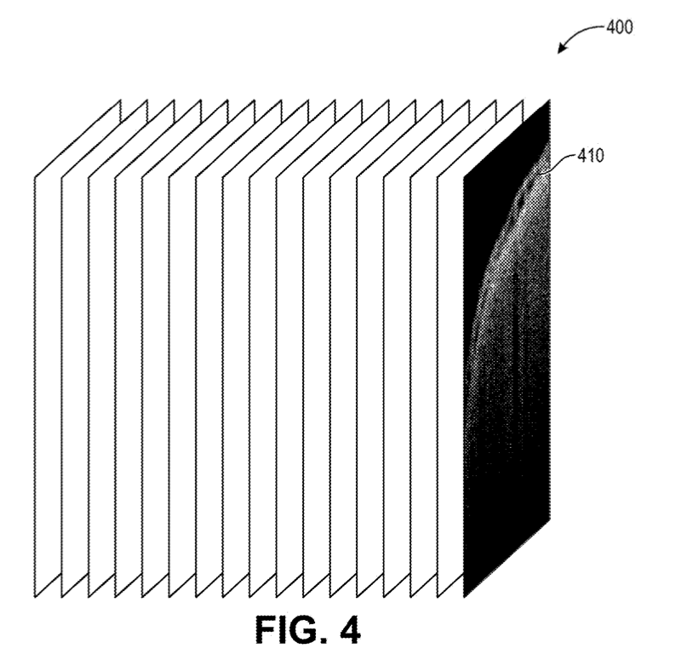
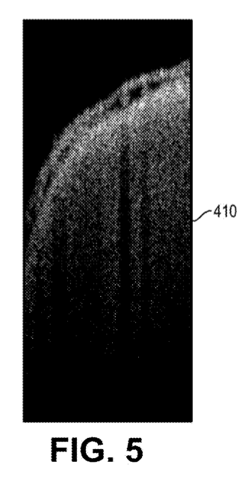

Step 1:
- Stack of slices captured by OCT sensor
- OCT sensor – top of figure, facing downward
- Each slice imaged at a particular depth
Problem: OCT may pick up background signal/noise artifacts
Example Slice

Slide 12
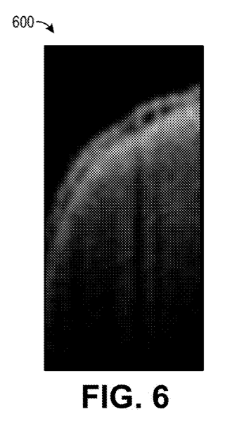
Step 2:
Spatial Smoothing:
Smooths out intensity values to filter out low signal + noise artifacts
e.g., Gaussian blur, median blur, bilateral blur, etc.
Fig. 6 uses Gaussian blur

Slide 13
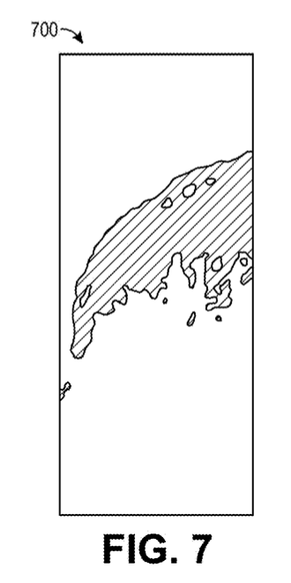
Step 3:
Performed by processing unit
K-means method:
White spots – above threshold value
Dark spots – below threshold value
Threshold – based on known pixel intensities for measured brain surface
Alternatively: Can also use Otsu’s method to minimize (or maximize) intraclass variance

Slide 14
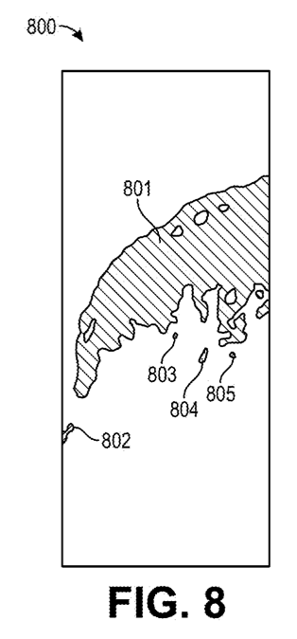
Step 4:
Connected component analysis:
- Identify “blobs” (regions of threshold intensity values forming continuous structures)
- Look for continuity in each segmented slice
- Evaluate whether region fulfills qualifying pixel size

Slide 15


Step 5:
Size of blobs – can use continuity length as threshold
Keep this blob
(above 50% of slide width)
Filtered out!
(below 50% of slide width)

Slide 16
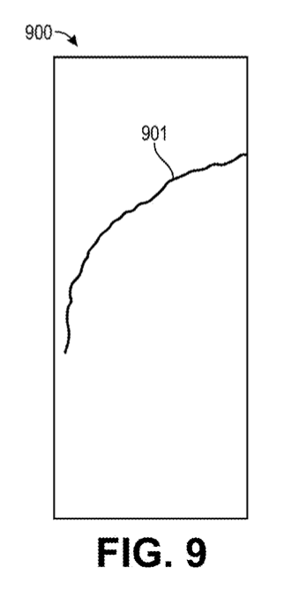
Step 6:
Identify an edge on blob that is not filtered in step 5
Resultant edge of top edge blob 801

Slide 17
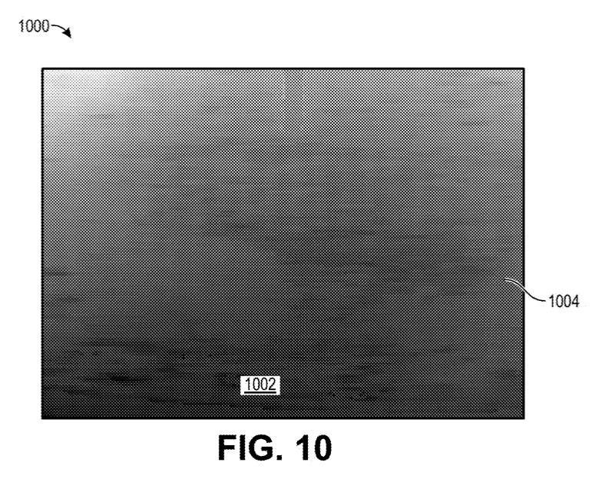
Step 6.5: Apply Image Derivatives to Compile 32-bit Depth Map
Problem:
Noise produced via image derivatives - does not account for shadows of other electrodes in brain (detected surface much higher than actual)
Portion of skull
Brain surface
(can be seen along bottom of depth map to guide robot inserter head)

Slide 18
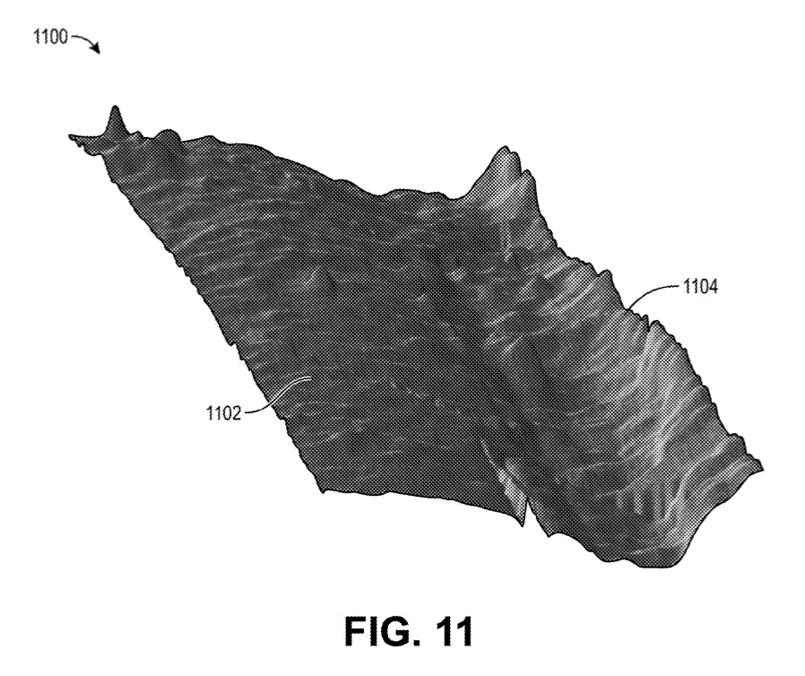
Step 7:
Solution: Selective median filter
Identify median points along edges
Filters out noise + artifacts
Forms 3D surface topography
Selective mean filter – selects only a location in space (instead of valid surface location)
Portion of skull
Brain surface

Slide 19
Step 8:
Portion of skull
Brain surface

Slide 20

Overall Procedure Flow Map
Guide Robotic End Effector
Series of Slices
3D Render
Selective Median Filter
Connected Component analysis
Filter
(based on sizes)
Image Derivatives
Spatial smoothing
Edge Detection
Thresholding
Example Slice
Blurred Slice
Segmented Slice
Blobs Detected
Blobs Filtered Out
Edge Detection Slice
Depth Map

Slide 21
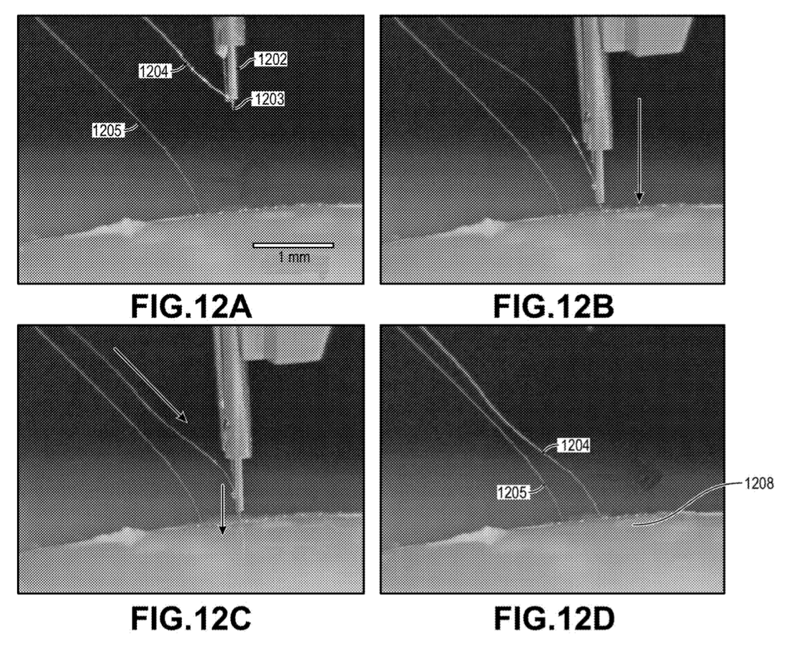
Implantation of Electrodes in Target Tissue Proxy Substance
Inserter head
2. Lowering of Surgical Robotic End Effector
1. Pre-implantation
1st Thread
Needle
2nd Thread
3. Insertion of electrode
4. Final electrode left
1st Thread
2nd Thread
Target tissue proxy substance

Slide 22
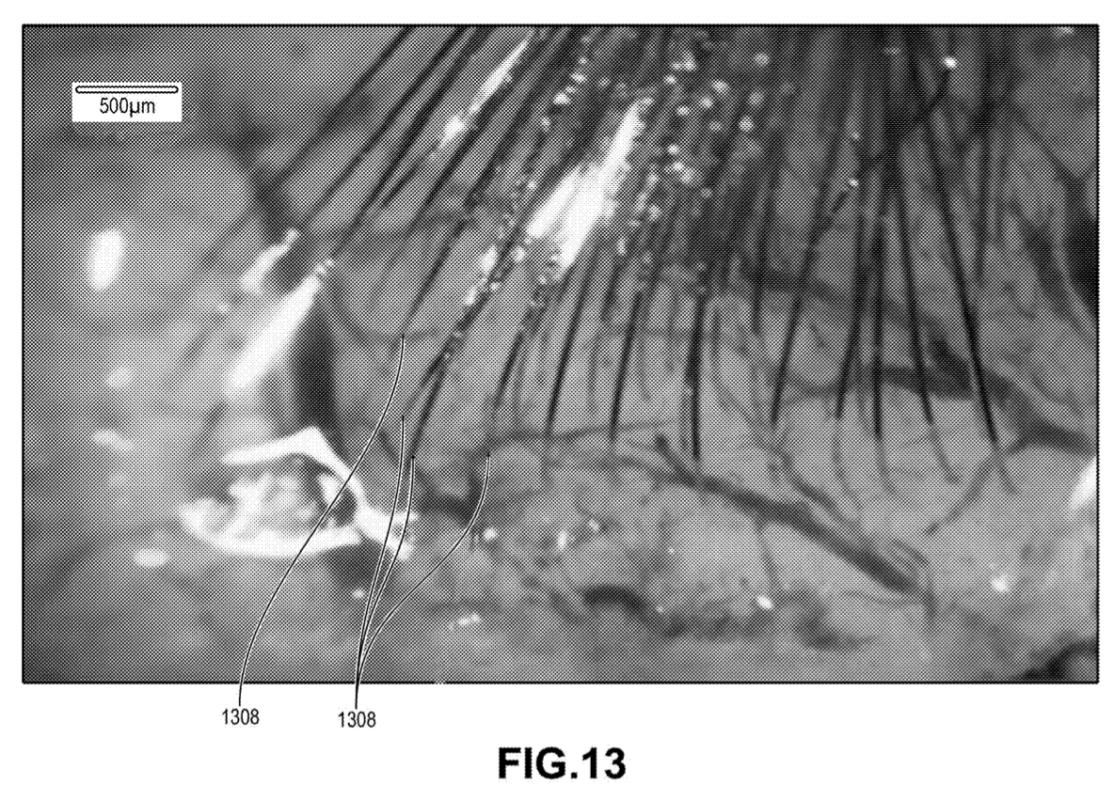
Electrodes implanted in brain tissue
96 threads
32 electrodes per thread (total 3,072 electrodes)
Thread:
width 5-50µm
thickness 4-6µm
length 20mm
Several initially inserting threads can cast shadows – impact later threads
Threads in close proximity

Slide 23
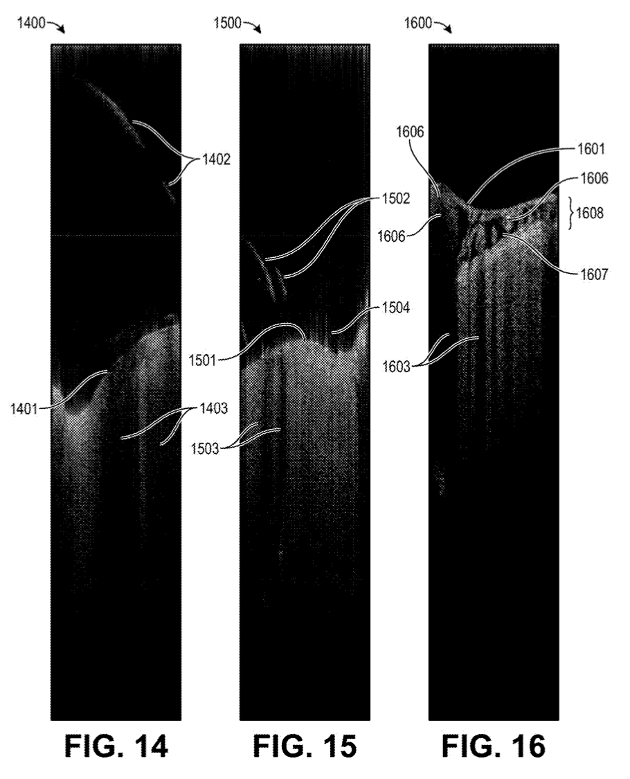
Shadows Cast By Threads
Thread(s) that cast shadows results in inaccurate portrayal of region
Thread that casts a shadow
Threads that cast shadows
Artifacts
Brain surface
Brain surface
Drop in intensity due to above thread 1402
Drop in intensity
Single Thread
Multiple Threads

Slide 24
Occlusions Casted from Fluid & Vessels
Shadows cast from fluid and vessels
OCT data alone (without processing) is less precise
Selective median filter removes noise/artifacts
High intensity regions
Brain surface
High intensity regions
High intensity regions
Arachnoid space
CSF flowing along brain (OCT sensor has trouble picking up)
Shadows
(cast from fluid and vessels along surface of brain)
Vessels, Vasculatures, etc.

Slide 25
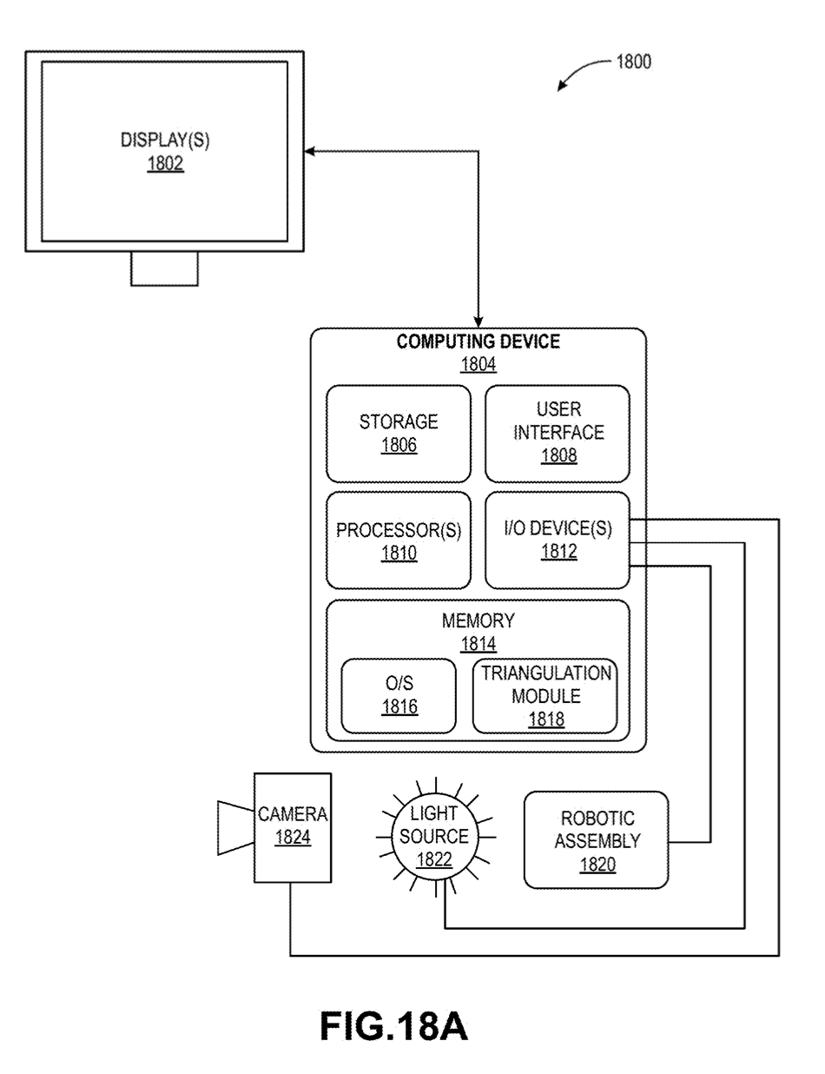
Example Computing System

Slide 26
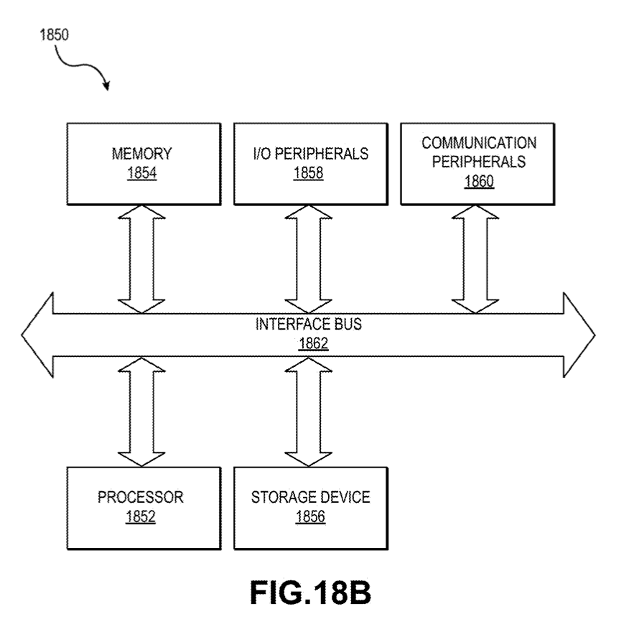
Components for Example Computing System

